Slide 1
CPR E 281: Digital Logic
Md Maruf Ahamed
Office: 307 Durham Center
Phone: (515) 294-6323
Email: maruf@iastate.edu

Slide 2
Administrative Stuff
  Homework: HW#6 due on Sunday @ 11:59 PM
  Quiz: Quiz #6 due on Friday @ 4:25 PM
  Recitation: Recitation 6 this week
  Lab: Lab 6 this week
  Lecture-20 Readings: Section 4.4 and 4.5

Slide 3
20-Code Converters
  Encoders
    Binary Encoders
    Priority Encoders
  Code Converters
  Design a Comparator Circuit
  Implement Logic Function Using Decoders
  Design a Shifter Circuit

Slide 4
Encoders (there are several types)
An encoder performs the opposite function of a decoder. It encodes given information into a more compact form.
Encoders are used to reduce the number of bits needed to represent given information.
A practical use of encoders is for transmitting information in a digital system.
Encoding the information allows the transmission link to be built using fewer wires.
Encoding is also useful if information is to be stored for later use because fewer bits need to be stored.

Slide 5
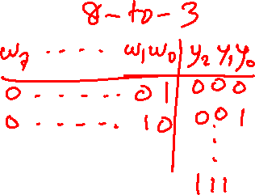
Truth table for a 4-to-2 binary encoder
w
w
w
w
y
y
3
2
1
0
1
0
0
0
0
1
0
0
0
0
1
0
0
1
0
1
0
0
1
0
1
0
0
0
1
1
[ Figure 4.19 from the textbook ]

Slide 6
Priority Encoders

Slide 7
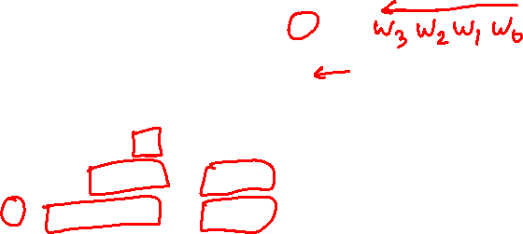
Truth table for a 4-to-2 priority encoder
w
w
w
w
y
y
z
3
2
1
0
1
0
0
0
0
0
d
d
0
0
0
0
1
0
0
1
0
0
1
x
0
1
1
0
1
x
x
1
0
1
1
x
x
x
1
1
1
In a priority encoder each input has a priority level associated with it. The encoder outputs indicate the active input that has the highest priority.
When an input with a high priority is asserted, the other inputs with lower priority are ignored.
It assumes that w₀ has the lowest priority and w₃ the highest.
Since it is possible that none of the inputs is equal to 1, an output, z, is provided to indicate this condition.
[ Figure 4.20 from the textbook ]

Slide 8
Truth table for a 4-to-2 priority encoder
(abbreviated version)
w
w
w
w
y
y
z
3
2
1
0
1
0
0
0
0
0
d
d
0
0
0
0
1
0
0
1
0
0
1
x
0
1
1
0
1
x
x
1
0
1
1
x
x
x
1
1
1
[ Figure 4.20 from the textbook ]

Slide 9
Truth table for a 4-to-2 priority encoder
w₃ | w₂ | w₁ | w₀ | y₁ | y₀ | z
0 | 0 | 0 | 0 | d | d | 0
0 | 0 | 0 | 1 | 0 | 0 | 1
0 | 0 | 1 | 0 | 0 | 1 | 1
0 | 0 | 1 | 1 | 0 | 1 | 1
0 | 1 | 0 | 0 | 1 | 0 | 1
0 | 1 | 0 | 1 | 1 | 0 | 1
0 | 1 | 1 | 0 | 1 | 0 | 1
0 | 1 | 1 | 1 | 1 | 0 | 1
1 | 0 | 0 | 0 | 1 | 1 | 1
1 | 0 | 0 | 1 | 1 | 1 | 1
1 | 0 | 1 | 0 | 1 | 1 | 1
1 | 0 | 1 | 1 | 1 | 1 | 1
1 | 1 | 0 | 0 | 1 | 1 | 1
1 | 1 | 0 | 1 | 1 | 1 | 1
1 | 1 | 1 | 0 | 1 | 1 | 1
1 | 1 | 1 | 1 | 1 | 1 | 1
0 0 0 0
0 0 0 1
0 0 1 x
0 1 x x
1 x x x

Slide 10
Expressions for 4-to-2 priority encoder
w₃ | w₂ | w₁ | w₀ | y₁ | y₀ | z
0 | 0 | 0 | 0 | d | d | 0
0 | 0 | 0 | 1 | 0 | 0 | 1
0 | 0 | 1 | 0 | 0 | 1 | 1
0 | 0 | 1 | 1 | 0 | 1 | 1
0 | 1 | 0 | 0 | 1 | 0 | 1
0 | 1 | 0 | 1 | 1 | 0 | 1
0 | 1 | 1 | 0 | 1 | 0 | 1
0 | 1 | 1 | 1 | 1 | 0 | 1
1 | 0 | 0 | 0 | 1 | 1 | 1
1 | 0 | 0 | 1 | 1 | 1 | 1
1 | 0 | 1 | 0 | 1 | 1 | 1
1 | 0 | 1 | 1 | 1 | 1 | 1
1 | 1 | 0 | 0 | 1 | 1 | 1
1 | 1 | 0 | 1 | 1 | 1 | 1
1 | 1 | 1 | 0 | 1 | 1 | 1
1 | 1 | 1 | 1 | 1 | 1 | 1
w₃ w₂
w₁ w₀
00
01
11
10
00
d
1
1
1
01
0
1
1
1
11
0
1
1
1
10
0
1
1
1
y₁ = w₃ + w₂

Slide 11
Expressions for 4-to-2 priority encoder
w₃ | w₂ | w₁ | w₀ | y₁ | y₀ | z
0 | 0 | 0 | 0 | d | d | 0
0 | 0 | 0 | 1 | 0 | 0 | 1
0 | 0 | 1 | 0 | 0 | 1 | 1
0 | 0 | 1 | 1 | 0 | 1 | 1
0 | 1 | 0 | 0 | 1 | 0 | 1
0 | 1 | 0 | 1 | 1 | 0 | 1
0 | 1 | 1 | 0 | 1 | 0 | 1
0 | 1 | 1 | 1 | 1 | 0 | 1
1 | 0 | 0 | 0 | 1 | 1 | 1
1 | 0 | 0 | 1 | 1 | 1 | 1
1 | 0 | 1 | 0 | 1 | 1 | 1
1 | 0 | 1 | 1 | 1 | 1 | 1
1 | 1 | 0 | 0 | 1 | 1 | 1
1 | 1 | 0 | 1 | 1 | 1 | 1
1 | 1 | 1 | 0 | 1 | 1 | 1
1 | 1 | 1 | 1 | 1 | 1 | 1
w₃ w₂
w₁ w₀
00
01
11
10
00
d
0
1
1
01
0
0
1
1
11
1
0
1
1
10
1
0
1
1
y₀ = w₃ + w₁ w₂

Slide 12

Expressions for 4-to-2 priority encoder
w₃ | w₂ | w₁ | w₀ | y₁ | y₀ | z
0 | 0 | 0 | 0 | d | d | 0
0 | 0 | 0 | 1 | 0 | 0 | 1
0 | 0 | 1 | 0 | 0 | 1 | 1
0 | 0 | 1 | 1 | 0 | 1 | 1
0 | 1 | 0 | 0 | 1 | 0 | 1
0 | 1 | 0 | 1 | 1 | 0 | 1
0 | 1 | 1 | 0 | 1 | 0 | 1
0 | 1 | 1 | 1 | 1 | 0 | 1
1 | 0 | 0 | 0 | 1 | 1 | 1
1 | 0 | 0 | 1 | 1 | 1 | 1
1 | 0 | 1 | 0 | 1 | 1 | 1
1 | 0 | 1 | 1 | 1 | 1 | 1
1 | 1 | 0 | 0 | 1 | 1 | 1
1 | 1 | 0 | 1 | 1 | 1 | 1
1 | 1 | 1 | 0 | 1 | 1 | 1
1 | 1 | 1 | 1 | 1 | 1 | 1
w₃ w₂
w₁ w₀
00
01
11
10
00
0
1
1
1
01
1
1
1
1
11
1
1
1
1
10
1
1
1
1
z = w₃ + w₂ + w₁ + w₀

Slide 13
Circuit for the 4-to-2 priority encoder
w₃ w₂ w₁ w₀
y₀
y₁
z

Slide 14
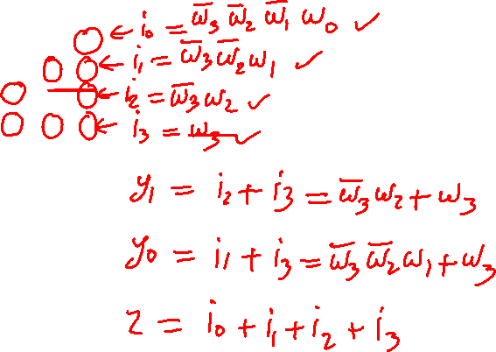
The textbook derives a different circuit for the
4-to-2 priority encoder using a 4-to-2 binary encoder
w
w
w
w
y
y
z
3
2
1
0
1
0
0
0
0
0
d
d
0
0
0
0
1
0
0
1
0
0
1
x
0
1
1
0
1
x
x
1
0
1
1
x
x
x
1
1
1

Slide 15
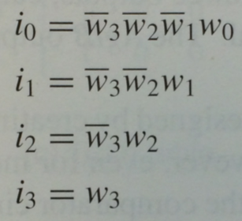
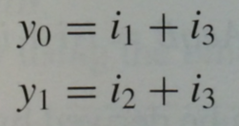

The textbook derives a different circuit for the
4-to-2 priority encoder using a 4-to-2 binary encoder
w
w
w
w
y
y
z
3
2
1
0
1
0
0
0
0
0
d
d
0
0
0
0
1
0
0
1
0
0
1
x
0
1
1
0
1
x
x
1
0
1
1
x
x
x
1
1
1

Slide 16
The textbook derives a different circuit for the
4-to-2 priority encoder using a 4-to-2 binary encoder
w
w
w
w
y
y
z
3
2
1
0
1
0
0
0
0
0
d
d
0
0
0
0
1
0
0
1
0
0
1
x
0
1
1
0
1
x
x
1
0
1
1
x
x
x
1
1
1
w
0
w
1
y
0
w
2
y
w
1
3

Slide 17

The textbook derives a different circuit for the
4-to-2 priority encoder using a 4-to-2 binary encoder
w
w
w
w
y
y
z
3
2
1
0
1
0
0
0
0
0
d
d
0
0
0
0
1
0
0
1
0
0
1
x
0
1
1
0
1
x
x
1
0
1
1
x
x
x
1
1
1
i₀
i₁
i₂
i₃
w
0
w
1
y
0
w
2
y
w
1
3
i₀ + i₁ + i₂ + i₃
z
Try to prove that this is equivalent to the circuit that was derived above.

Slide 18
Code Converters
Readings 4.4, 4.5

Slide 19
Code Converter (Definition)
Converts from one type of input encoding to a different type of output encoding.
A decoder does that as well, but its outputs are always one-hot encoded so the output code is really only one type of output code.
A binary encoder does that as well but its inputs are always one-hot encoded so the input code is really only one type of input code.

Slide 20
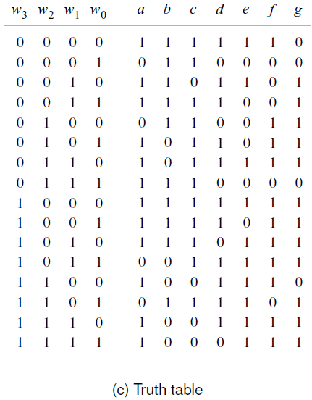
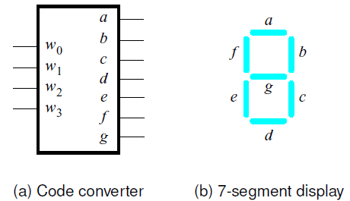
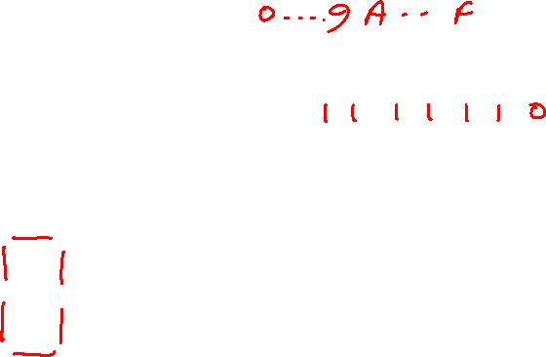
A hex-to-7-segment display code converter
[ Figure 4.21 from the textbook ]

Slide 21
A hex-to-7-segment display code converter
[ Figure 4.21 from the textbook ]

Slide 22
A hex-to-7-segment display code converter
[ Figure 4.21 from the textbook ]

Slide 23
A hex-to-7-segment display code converter
[ Figure 4.21 from the textbook ]

Slide 24
What is the circuit for this code converter?
x₃ x₂ x₁ x₀

Slide 25
What is the circuit for this code converter?
x₃ x₂ x₁ x₀
f(x₁, x₂, x₃, x₄) = Σ m(0, 2, 3, 5, 6, 7, 8, 9, 10, 12, 14, 15)

Slide 26
What is the circuit for this code converter?
x₃ x₂ x₁ x₀
1
0
1
1
0
1
0
1
1
1
1
0
1
1
1
1
f(x₁, x₂, x₃, x₄) = Σ m(0, 2, 3, 5, 6, 7, 8, 9, 10, 12, 14, 15)

Slide 27
What is the circuit for this code converter?
x₃ x₂ x₁ x₀

Slide 28
What is the circuit for this code converter?
x₃ x₂ x₁ x₀
1
0
1
1
0
1
1
1
1
0
0
1
1
1
1
0
f(x₁, x₂, x₃, x₄) = Σ m(0, 2, 3, 5, 6, 8, 9, 11, 12, 13, 14)

Slide 29
Arithmetic Comparison Circuits

Slide 30
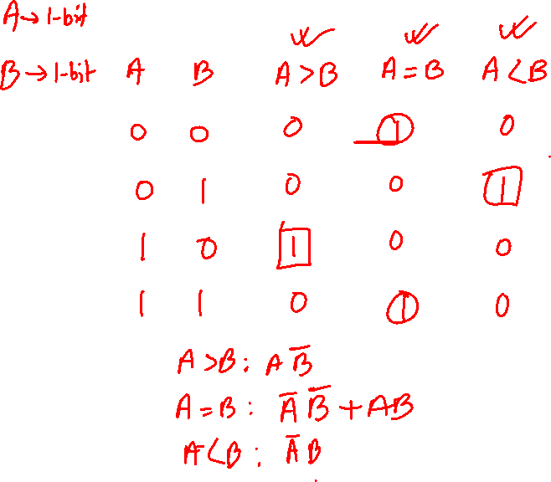
Truth table for a one-bit digital comparator
Inputs |  | Outputs
[http://en.wikipedia.org/wiki/Digital_comparator]

Slide 31
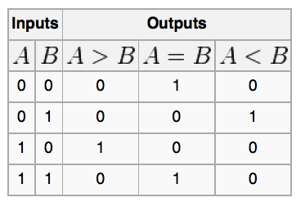
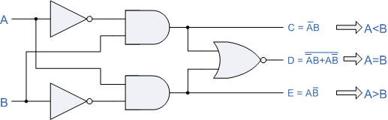
A one-bit digital comparator circuit
[http://www.personal.psu.edu/users///c/w/cwb5096/Old%20Site/index_files/cmpenlab4.htm]

Slide 32
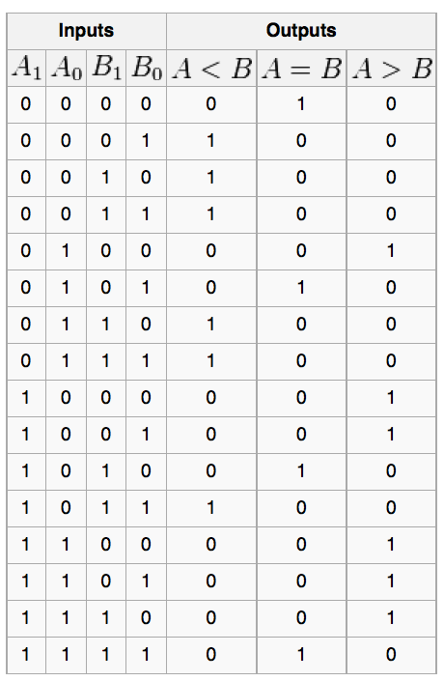
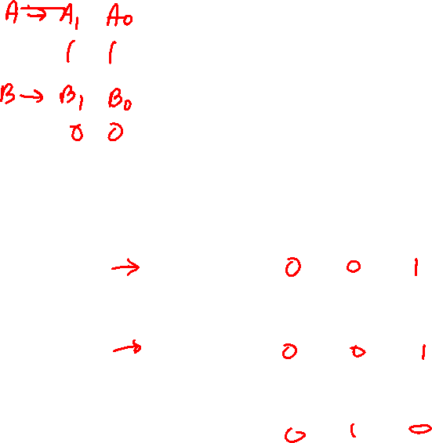
Truth table for a two-bit digital comparator
[http://en.wikipedia.org/wiki/Digital_comparator]

Slide 33

Truth table for a two-bit digital comparator
[http://en.wikipedia.org/wiki/Digital_comparator]

Slide 34
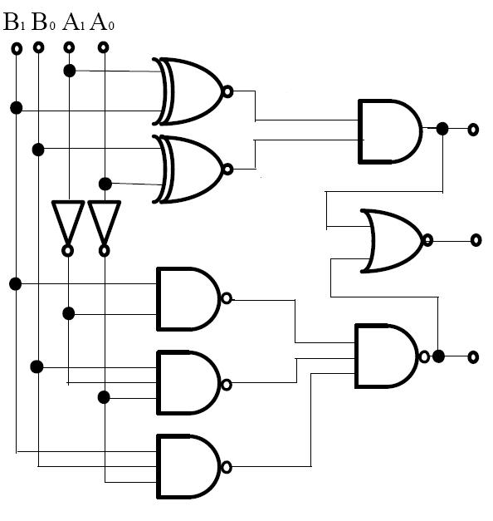
A two-bit digital comparator circuit
A = B
A < B
A > B
[http://forum.allaboutcircuits.com/showthread.php?t=10561]

Slide 35
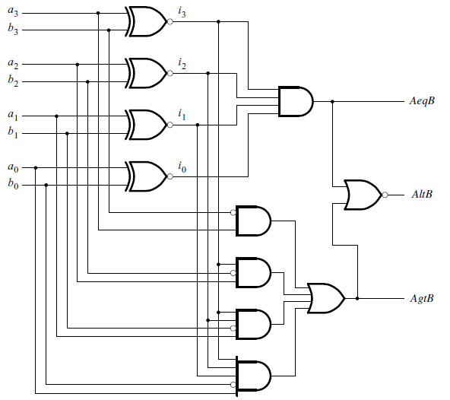
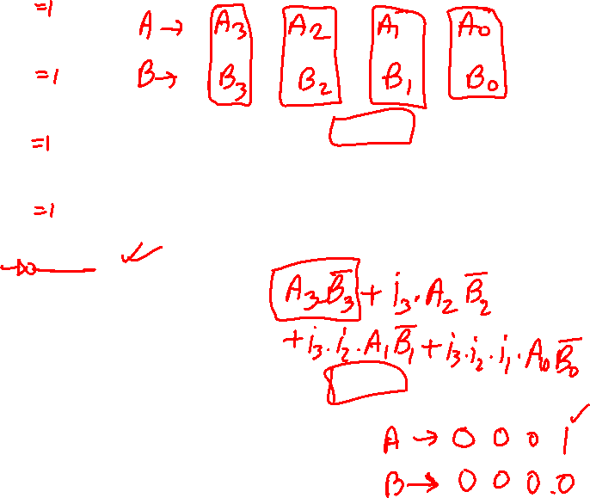
A four-bit comparator circuit
A = B
A < B
A > B
[ Figure 4.22 from the textbook ]

Slide 36
Example Problems from Chapter 4

Slide 37
Example 1: SOP vs Decoders
Implement the function
f(w₁, w₂, w₃) = Σ m(0, 1, 3, 4, 6, 7)
by using a 3-to-8 binary decoder and one OR gate.

Slide 38
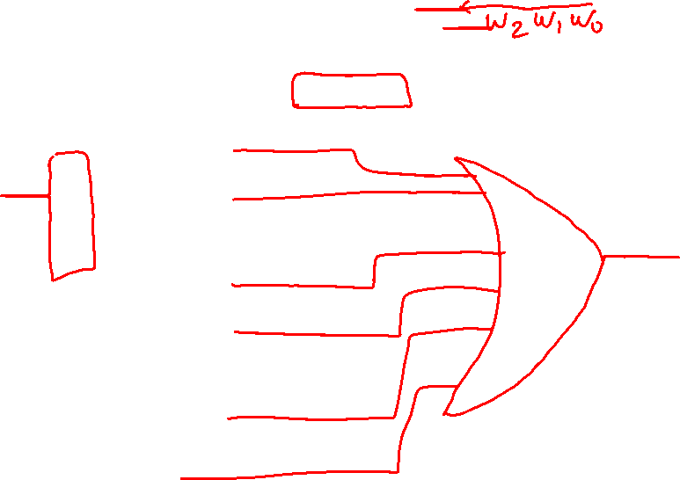
Solution Circuit
f(w₁, w₂, w₃) = Σ m(0, 1, 3, 4, 6, 7)
w₃
w₀
y₀
w₂
w₁
y₁
w₁
w₂
y₂
y₃
y₄
y₅
y₆
1
En
y₇
f(w₁, w₂, w₃) = Σ m(0, 1, 3, 4, 6, 7)
[ Figure 4.44 from the textbook ]

Slide 39
Solution Circuit
Notice this swap
of variables in
the two lists.
f(w₁, w₂, w₃) = Σ m(0, 1, 3, 4, 6, 7)
w₃
w₀
y₀
w₂
w₁
y₁
w₁
w₂
y₂
Need to match the
least significant
with the least
significant in both.
y₃
y₄
y₅
y₆
1
En
y₇
f(w₁, w₂, w₃) = Σ m(0, 1, 3, 4, 6, 7)
[ Figure 4.44 from the textbook ]

Slide 40

Solution Circuit
f(w₁, w₂, w₃) = Σ m(0, 1, 3, 4, 6, 7)
w₃
w₀
y₀
w₂
w₁
y₁
w₁
w₂
y₂
y₃
y₄
y₅
y₆
1
En
y₇
f(w₁, w₂, w₃) = Σ m(0, 1, 3, 4, 6, 7)
[ Figure 4.44 from the textbook ]

Slide 41
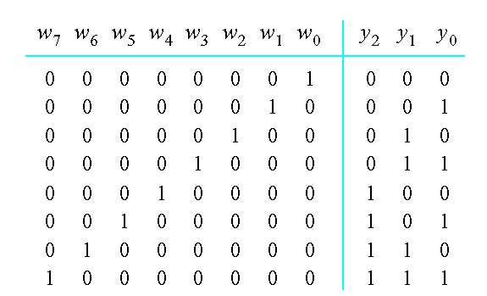
Example 2: Implement an 8-to-3 binary encoder
[ Figure 4.45 from the textbook ]

Slide 42
Example 2: Implement an 8-to-3 binary encoder
y₀ = w₁ + w₃ + w₅ + w₇
y₁ = w₂ + w₃ + w₆ + w₇
y₂ = w₄ + w₅ + w₆ + w₇
[ Figure 4.45 from the textbook ]

Slide 43
Circuit for the 8-to-3 binary encoder
w₇ w₆ w₅ w₄ w₃ w₂ w₁ w₀
y₀
y₁
y₂
y₀ = w₁ + w₃ + w₅ + w₇
y₁ = w₂ + w₃ + w₆ + w₇
y₂ = w₄ + w₅ + w₆ + w₇

Slide 44
Example 3: Implement an 8-to-3 priority encoder

Slide 45

Example 3: Implement an 8-to-3 priority encoder
x
x x
x x x
x x x x
x x x x x
x x x x x x
x x x x x x x

Slide 46

Example 3: Implement an 8-to-3 priority encoder
z
1 1 1
1
1
1
1
1
0
x
x x
x x x
x x x x
x x x x x
x x x x x x
x x x x x x x
0 0 0 0 0 0 0 0
d d d

Slide 47
Example 3: Implement an 8-to-3 priority encoder
z
1 1 1
1
1
1
1
1
0
x
x x
x x x
x x x x
x x x x x
x x x x x x
x x x x x x x
0 0 0 0 0 0 0 0
d d d

Slide 48
Example 3: Implement an 8-to-3 priority encoder
z
1 1 1
1
1
1
1
1
0
i₀ = w₇ w₆ w₅ w₄ w₃ w₂ w₁ w₀
i₁ = w₇ w₆ w₅ w₄ w₃ w₂ w₁
i₂ = w₇ w₆ w₅ w₄ w₃ w₂
i₃ = w₇ w₆ w₅ w₄ w₃
x
x x
x x x
i₄ = w₇ w₆ w₅ w₄
i₅ = w₇ w₆ w₅
i₆ = w₇ w₆
i₇ = w₇
x x x x
x x x x x
x x x x x x
x x x x x x x
z = i₀+i₁+i₂+i₃+i₄+i₅+i₆+i₇
0 0 0 0 0 0 0 0
d d d

Slide 49
Circuit for the 8-to-3 binary encoder
w₇ w₆ w₅ w₄ w₃ w₂ w₁ w₀
y₀
y₁
y₂

Slide 50
Circuit for the 8-to-3 priority encoder
i₇ i₆ i₅ i₄ i₃ i₂ i₁ i₀
w₇ w₆ w₅ w₄ w₃ w₂ w₁ w₀
y₀
y₁
y₂
z

Slide 51

Example 4:Circuit implementation using a multiplexer
Implement the function
f(w₁, w₂, w₃, w₄, w₅) = w₁ w₂ w₄ w₅ + w₁w₂ + w₁w₃ + w₁w₄ + w₃w₄w₅
using a 4-to-1 multiplexer

Slide 52





Example 4:Circuit implementation using a multiplexer
Note that the split is by w₁ and w₄, not w₁ and w₂

Slide 53
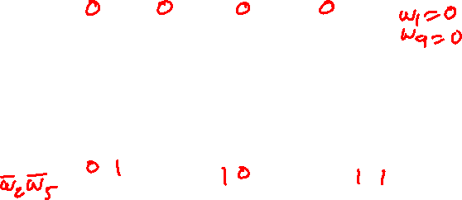

Example 4:Circuit implementation using a multiplexer
Note that the split is by w₁ and w₄, not w₁ and w₂

Slide 54
Example 4:Circuit implementation using a multiplexer
Note that the split is by w₁ and w₄, not w₁ and w₂

Slide 55
Some Boolean Algebra Leads To
w₁w₂w₄w₅ + w₁w₂ + w₁w₃ + w₁w₄ + w₃w₄w₅
w₁w₄ (w₅ w₂) + w₄ (w₃w₅) + w₁ (w₂ + w₃) + w₁w₄ (1)
w₁w₄ (w₅ w₂) + ( w₁+w₁)w₄ (w₃w₅) + w₁( w₄+w₄) (w₂ + w₃) + w₁w₄ (1)
w₁w₄ (w₅ w₂) + w₁w₄ (w₃w₅) + w₁w₄ (w₂ + w₃) + w₁w₄ ( w₃w₅ + (w₂+w₃) + 1)
w₁w₄ (w₅ w₂) + w₁w₄ (w₃w₅) + w₁w₄ (w₂ + w₃) + w₁w₄ (1)
Note that the split is by w₁ and w₄, not w₁ and w₂

Slide 56
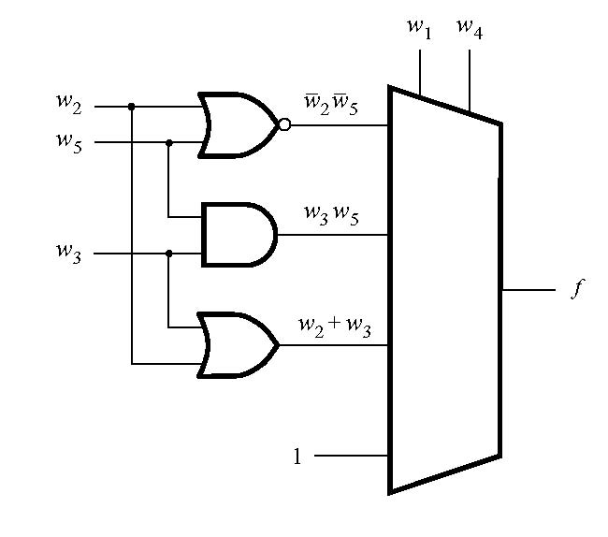


Solution Circuit
[ Figure 4.46 from the textbook ]

Slide 57

Example 5:Circuit implementation using a 2-to-4 Decoder
Implement the function
f(w₁, w₂, w₃, w₄, w₅) = w₁ w₂ w₄ w₅ + w₁w₂ + w₁w₃ + w₁w₄ + w₃w₄w₅
using a 2-to-4 Decoder

Slide 58
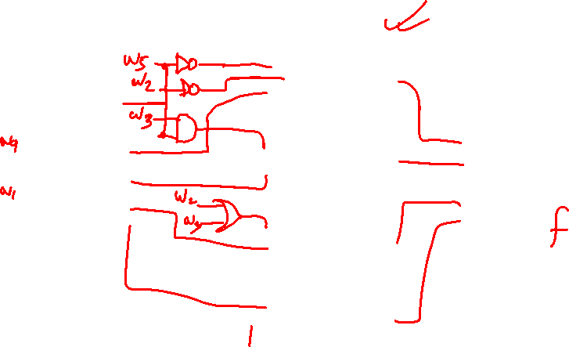
Example 5: Solution Circuit
w
y
0
0
w
y
1
1
y
2
En
y
3
[ Figure 4.46 from the textbook ]

Slide 59
Some Final Things from Chapter 4

Slide 60
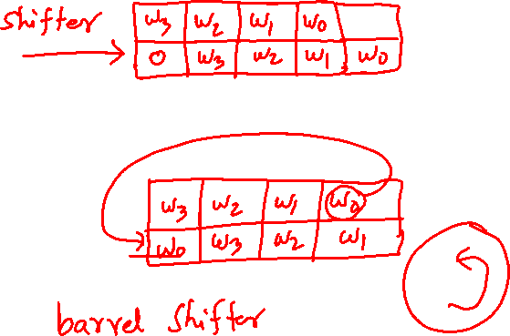
A shifter circuit
Example 4.30: Design a circuit that can shift a four-bit vector W = w₃w₂w₁w₀ one bit position to the right when a control signal Shift is equal to 1.
[ Figure 4.50 from the textbook ]

Slide 61
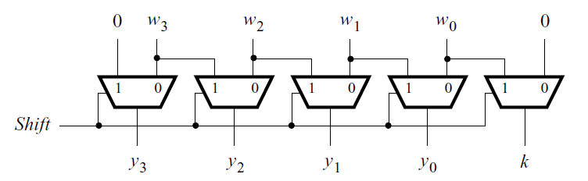
A shifter circuit
[ Figure 4.50 from the textbook ]

Slide 62
A shifter circuit
0

Slide 63
A shifter circuit
0

Slide 64
A shifter circuit
0
w₃
w₂
w₁
w₀
No shift in this case.

Slide 65
A shifter circuit
1

Slide 66
A shifter circuit
1

Slide 67
A shifter circuit
1
0
w₃
w₂
w₁
Shift to the right by 1 bit

Slide 68
A shifter circuit
1
0
w₃
w₂
w₁
w₀
Shift to the right by 1 bit

Slide 69
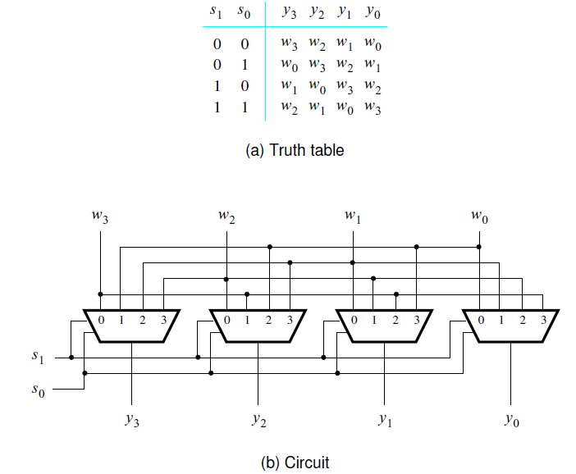
A barrel shifter circuit
If the bits that are shifted out are placed into the vacated positions on the left, then the circuit effectively rotates the bits of the input vector by a specified number of bit positions. Such a circuit is often called a barrel shifter.
[ Figure 4.51 from the textbook ]

Slide 70
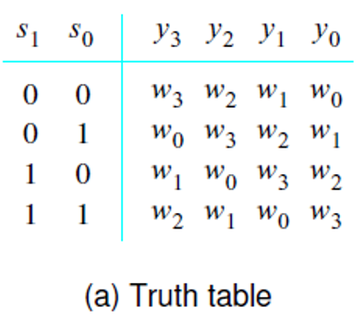

A barrel shifter circuit
If the bits that are shifted out are placed into the vacated positions on the left, then the circuit effectively rotates the bits of the input vector by a specified number of bit positions. Such a circuit is often called a barrel shifter.
[ Figure 4.51 from the textbook ]

Slide 71
A barrel shifter circuit
If the bits that are shifted out are placed into the vacated positions on the left, then the circuit effectively rotates the bits of the input vector by a specified number of bit positions. Such a circuit is often called a barrel shifter.
[ Figure 4.51 from the textbook ]

Slide 72

END Slide

